Slide 1


Improving Terrain Analysis and
Applications to RTS Game AI
Alberto Uriarte and Santiago Ontañón
Drexel University
Philadelphia
October 9, 2016

Slide 2
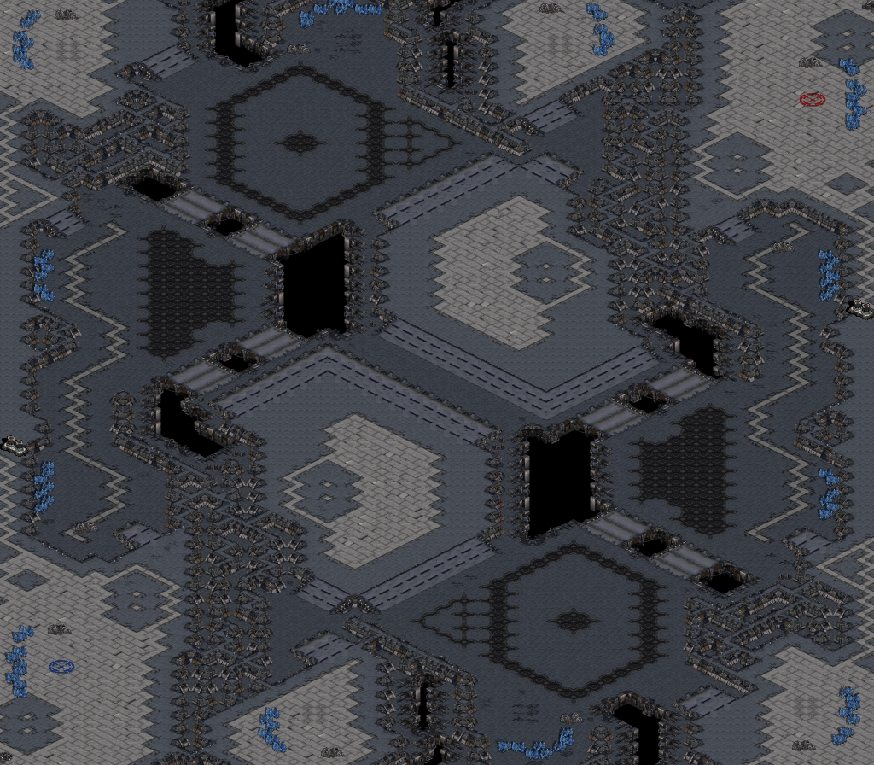
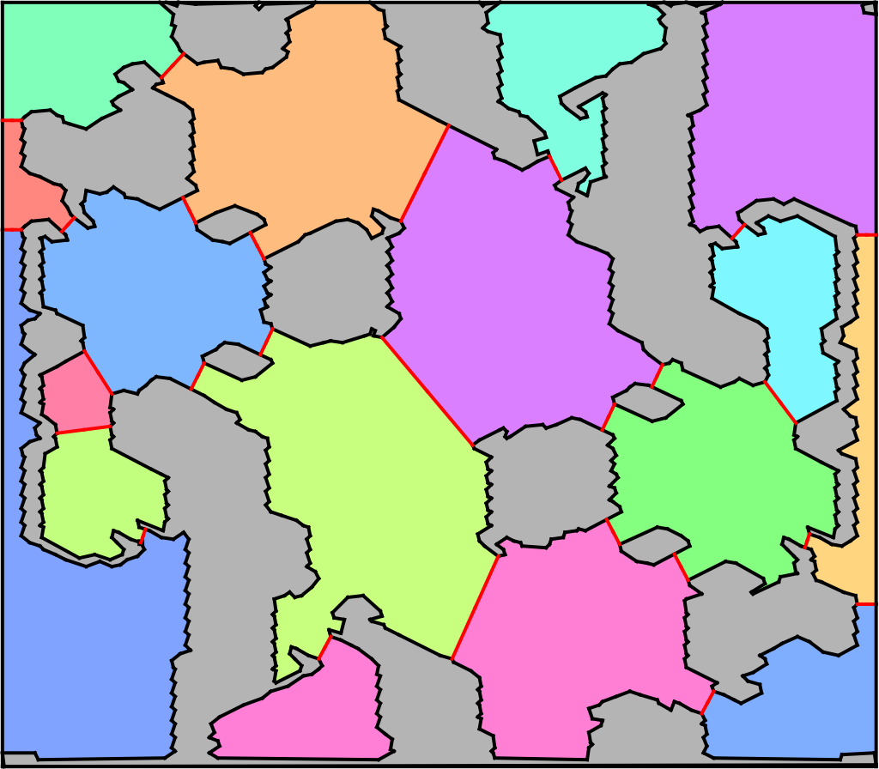
Motivation
BWTA is used by most of the StarCraft bots

Slide 3

Motivation
BWTA is used by most of the StarCraft bots
But it is slow

Slide 4

Motivation
BWTA is used by most of the StarCraft bots
But it is slow
False positive/negative

Slide 5
BWTA2 Overview
Similar steps than BWTA but optimized
Recognize Obstacle Polygons
Compute Voronoi Diagram
Prune Voronoi Diagram
Identify Nodes (Regions and Chokepoints)
Extract Region Polygons

Slide 6
BWTA2 Overview
Similar steps than BWTA but optimized
Recognize Obstacle Polygons
Compute Voronoi Diagram
Prune Voronoi Diagram
Identify Nodes (Regions and Chokepoints)
Extract Region Polygons
Same interface as BWTA
No dependency on CGAL

Slide 7
Recognize Obstacle Polygons
Convert to binary image
111111111111111111110000000000001111111111111111111
111111111111111111110000000000001111111111111111111
111111111111111111111100000000111111111111111111111
111111111111111111111111100000111111111111111111111
111111111111111111111111100000111111111111111111111
111111111111111111111110000000001111111111111111111
111111111111111111111000000000001111111111111111111
111111111111111100000000000000001111111111111111111
111111111111111100000000000000001111111111111111111
111111111111100000000000000000011111111111111111111
111111111111100000000000000000111111111111111111111
111111111111000000000000000011111111111111111111111
111111111111000000000000001111111111111111111111111
111111111111000000000000111111111111111111111111111
111111111111110000000000111111111111111111111111111
111111111111111110000011111111111111111111111111111
111111111111111110000011111111111111111111111111111
111111111111100000000000111111111111111111111111111
111111111111100000000000111111111111111111111111111
111111111111000000000000111111111111111111111111111
111111111111000000000000111111111111111111111111111
111111111111000000000000111111111111111111111111111
111111111111110000000011111111111111111111111111111
111111111111111110000011111111111111111111111111111
111111111111111110000011111111111111111111111111111
111111111111100000000000111111111111111111111111111
111111111111100000000000111111110111111111111111111
111111111111000000000000111111111111111111111111111
Walkable Tiles

Slide 8
Recognize Obstacle Polygons
Convert to binary image
111111111111111111110000000000001111111111111111111
111111111111111111110000000000001111111111111111111
111111111111111111111100000000111111111111111111111
111111111111111111111110000000011111111111111111111
111111111111111111111100000000111111111111111111111
111111111111111111111110000000001111111111111111111
111111111111111111111000000000001111111111111111111
111111111111111100000000000000001111111111111111111
111111111111111100000000000000001111111111111111111
111111111111100000000000000000011111111111111111111
111111111111100000000000000000111111111111111111111
111111111111000000000000000011111111111111111111111
111111111111000000000000001111111111111111111111111
111111111111000000000000111111111111111111111111111
111111111111110000000000111111111111111111111111111
111111111111100000000000111111111111111111111111111
111111111111110000000000111111111111111111111111111
111111111111100000000000111111111111111111111111111
111111111111100000000000111111111111111111111111111
111111111111000000000000111111111111111111111111111
111111111111000000000000111111111111111111111111111
111111111111000000000000111111111111111111111111111
111111111111110000000011111111111111111111111111111
111111111111100000000001111111111111111111111111111
111111111111110000000011111111111111111111111111111
111111111111100000000000111111111111111111111111111
111111111111100000000000111111110111111111111111111
111111111111000000000000111111111111111111111111111
Unmark tiles that
do not fit a small unit (3x3 walk tiles)

Slide 9
Recognize Obstacle Polygons
Convert to binary image
111111111111111111110000000000001111111111111111111
111111111111111111110000000000001111111111111111111
111111111111111111111100000000111111111111111111111
111111111111111111111110000000011111111111111111111
000000000000000000111100000000111111111111111111111
000000000000000000111110000000001111111111111111111
000000000000000000111000000000001111111111111111111
000000000000000000000000000000001111111111111111111
000000000000000000000000000000001111111111111111111
000000000000000000000000000000011111111111111111111
000000000000000000000000000000111111111111111111111
000000000000000000000000000011111111111111111111111
000000000000000000000000001111111111111111111111111
000000000000000000000000111111111111111111111111111
000000000000000000000000111111111111111111111111111
000000000000000000000000111111111111111111111111111
000000000000000000000000111111111111111111111111111
000000000000000000000000111111111111111111111111111
000000000000000000000000111111111111111111111111111
111111111111000000000000111111111111111111111111111
111111111111000000000000111111111111111111111111111
111111111111000000000000111111111111111111111111111
111111111111110000000011111111111111111111111111111
111111111111100000000001111111111111111111111111111
111111111111110000000011111111111111111111111111111
111111111111100000000000111111111111111111111111111
111111111111100000000000111111110111111111111111111
111111111111000000000000111111111111111111111111111
Unmark static and
undestroyable
buildings

Slide 10
Recognize Obstacle Polygons
Convert to binary image
111111111111111111112333333333321111111111111111111
111111111111111111112223333332221111111111111111111
111111111111111111111122333332111111111111111111111
111111111111111111111112333332211111111111111111111
222222222222222222111122333332111111111111111111111
233333333333333332111112333332221111111111111111111
233333333333333332111222333333321111111111111111111
233333333333333332222233333333321111111111111111111
233333333333333333333333333333221111111111111111111
233333333333333333333333333332211111111111111111111
233333333333333333333333333222111111111111111111111
233333333333333333333333322211111111111111111111111
233333333333333333333332221111111111111111111111111
233333333333333333333332111111111111111111111111111
233333333333333333333332111111111111111111111111111
233333333333333333333332111111111111111111111111111
233333333333333333333332111111111111111111111111111
233333333333333333333332111111111111111111111111111
222222222222233333333332111111111111111111111111111
111111111111233333333332111111111111111111111111111
111111111111233333333332111111111111111111111111111
111111111111222333333222111111111111111111111111111
111111111111112333333211111111111111111111111111111
111111111111122333333221111111111111111111111111111
111111111111112333333211111111111111111111111111111
111111111111122333333222111111111111111111111111111
111111111111123333333332111111114111111111111111111
111111111111223333333332111111111111111111111111111
Component-labeling
using contour tracing

Slide 11
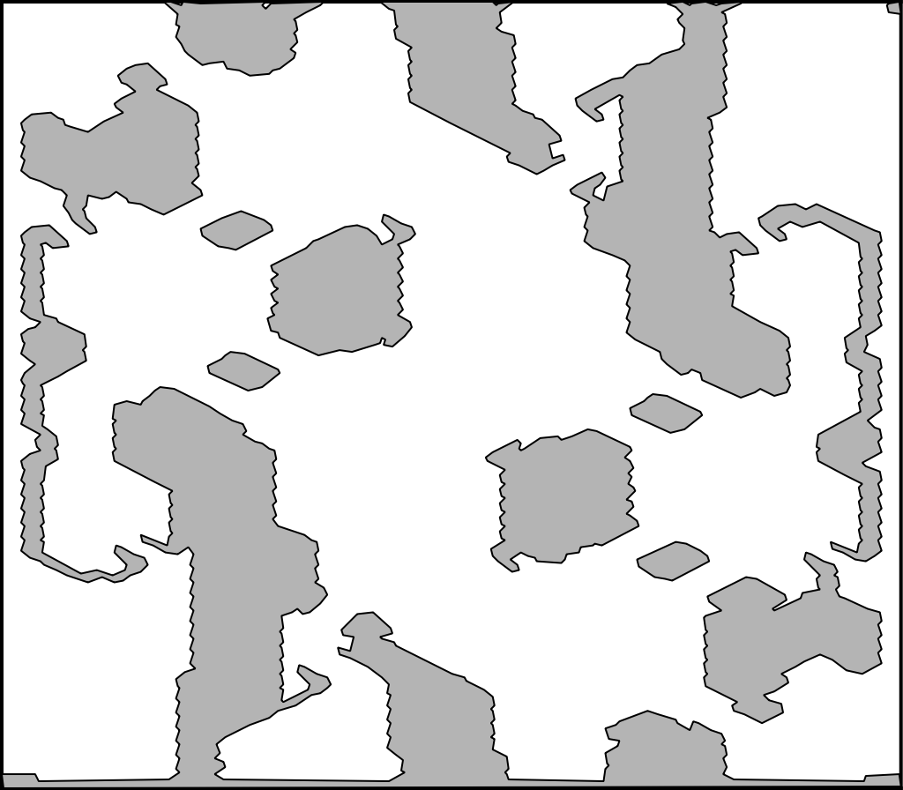
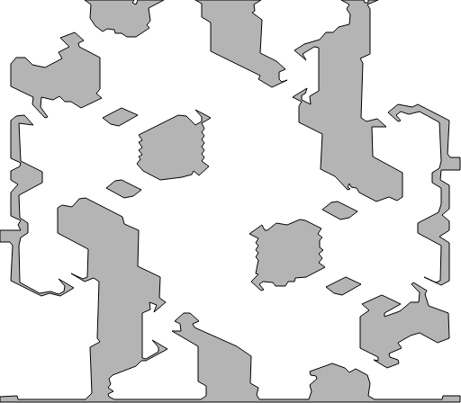
Recognize Obstacle Polygons
Simplify contour with Douglas-Peucker algorithm
BWTA
BWTA2
1.201 seconds
0.147005 seconds

Slide 12
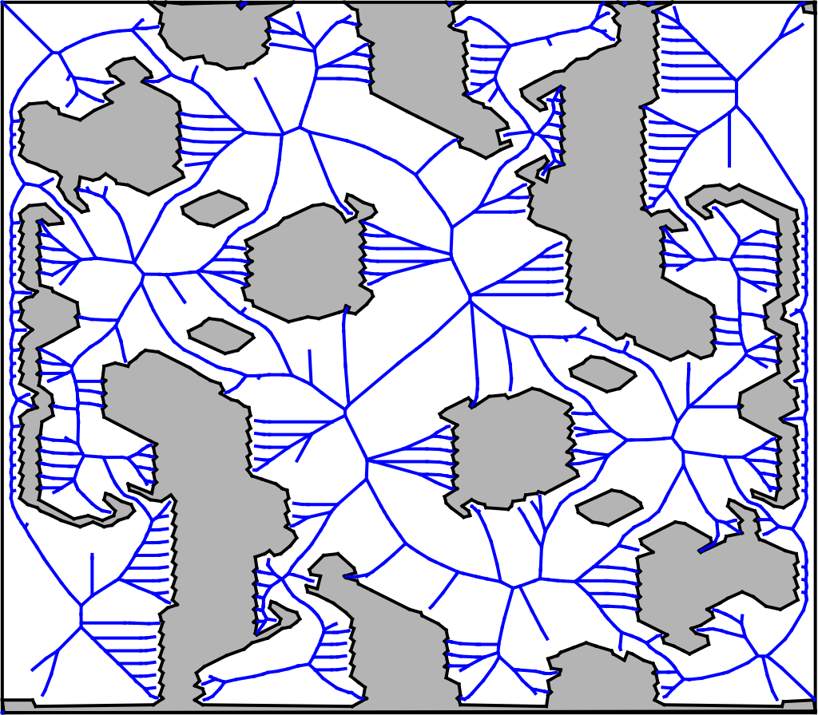
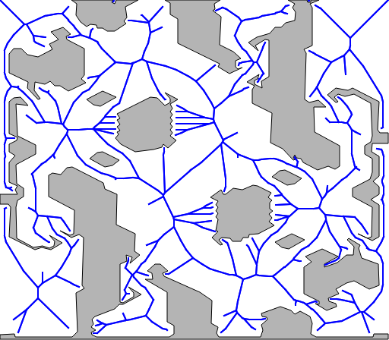
Compute Voronoi Diagram
CGAL -> Boost
Half-edge data structure -> Graph
BWTA
BWTA2
9.438 seconds
0.0410903 seconds

Slide 13
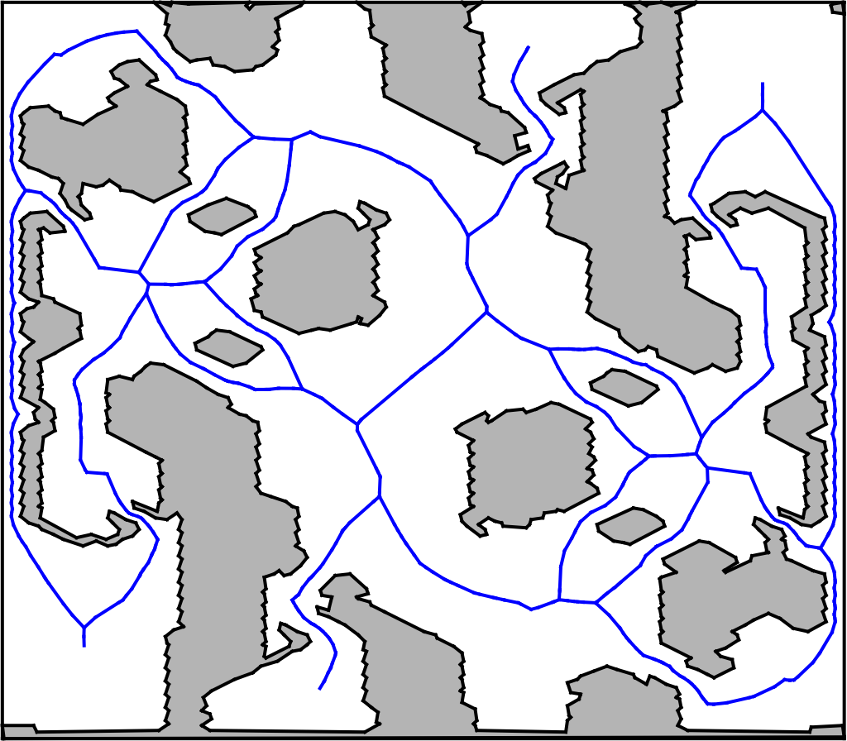
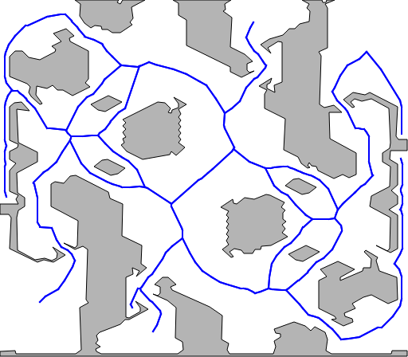
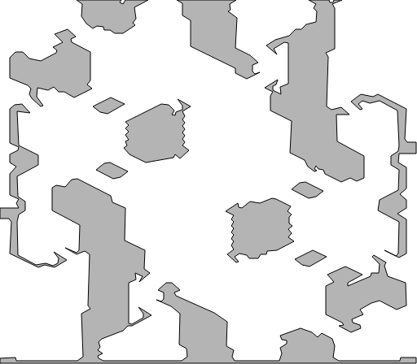
Prune Voronoi Diagram
R-tree to optimize distance queries
Remove vertex if leaf and parent farther to obstacle
BWTA
BWTA2
2.589 seconds
0.000126466 seconds

Slide 14
Identify Nodes
Algorithm Overview
All leaf nodes (local maxima) are marked as region nodes and all their children added to “explore” list.
Pop next vertex from explore list.
If the vertex has a degree other than two, we mark it as a region node since it is a leaf or an intersection point.
When a vertex has two children and it is a local minima, if the parent is also a local minima we mark as a chokepoint node only the vertex with the smallest radius, otherwise we mark the current vertex as a chokepoint node.
In the other hand, when a vertex with two children is a local maxima, if the parent is a local maxima we mark as a region node the vertex with the biggest radius, otherwise the current vertex is marked as a region node.
If children are not visited, add them to “explore” list and go back to step 2.

Slide 15
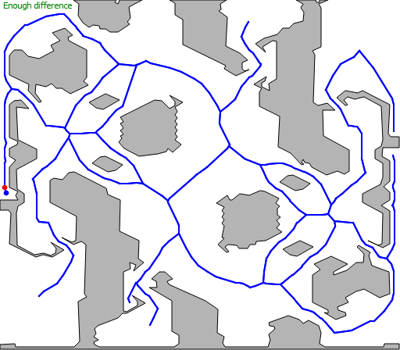
Identify Nodes
Demo

Slide 16
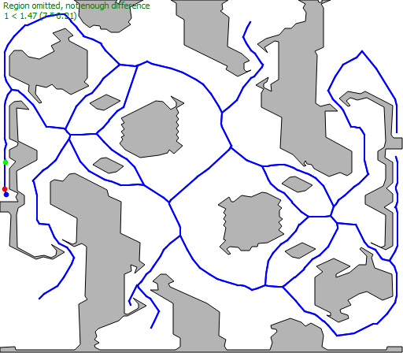
Identify Nodes
Demo

Slide 17
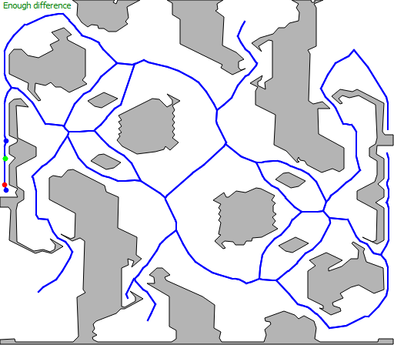
Identify Nodes
Demo

Slide 18

Identify Nodes
Demo

Slide 19

Identify Nodes
Demo

Slide 20
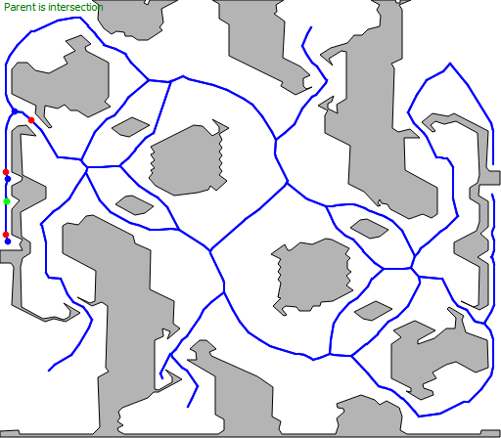
Identify Nodes
Demo

Slide 21
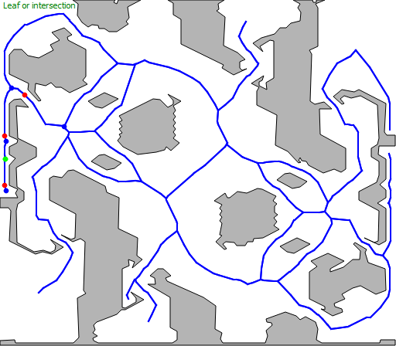
Identify Nodes
Demo

Slide 22
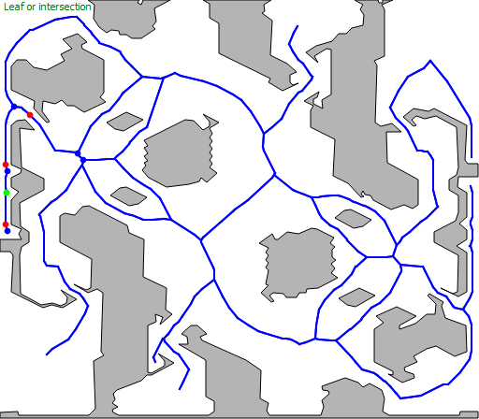
Identify Nodes
Demo

Slide 23

Identify Nodes
Demo

Slide 24
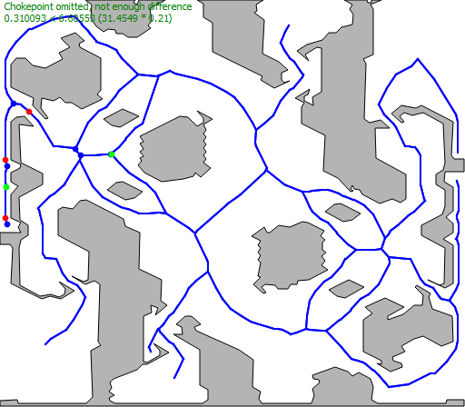
Identify Nodes
Demo

Slide 25
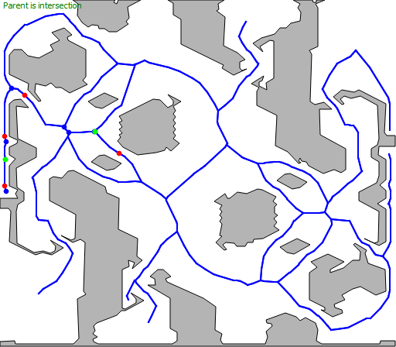
Identify Nodes
Demo

Slide 26

Identify Nodes
Demo

Slide 27

Identify Nodes
Demo

Slide 28
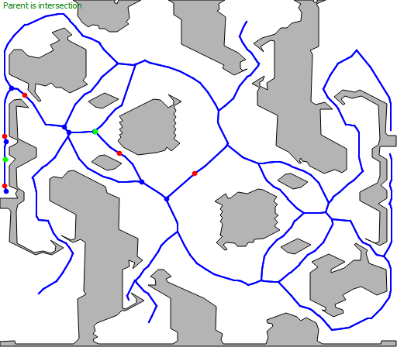
Identify Nodes
Demo

Slide 29
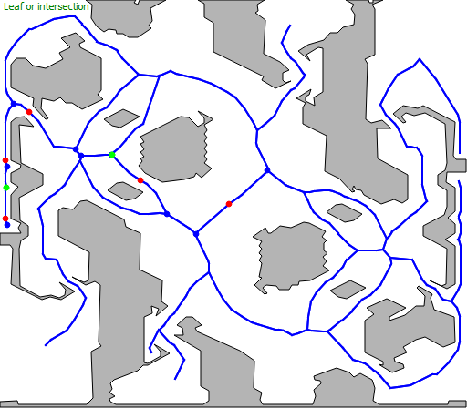
Identify Nodes
Demo

Slide 30

Identify Nodes
Demo

Slide 31

Identify Nodes
Demo

Slide 32
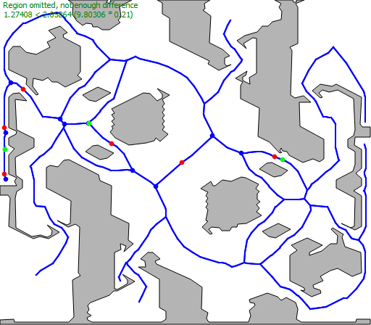
Identify Nodes
Demo

Slide 33
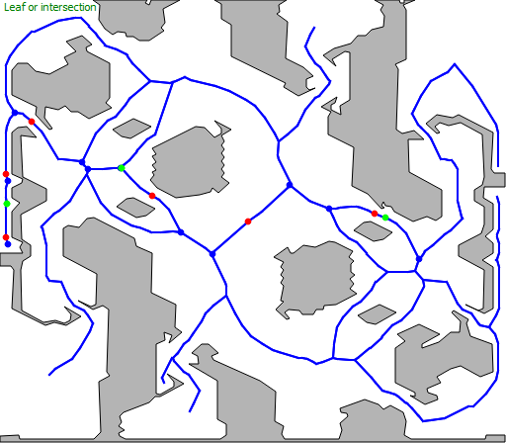
Identify Nodes
Demo

Slide 34
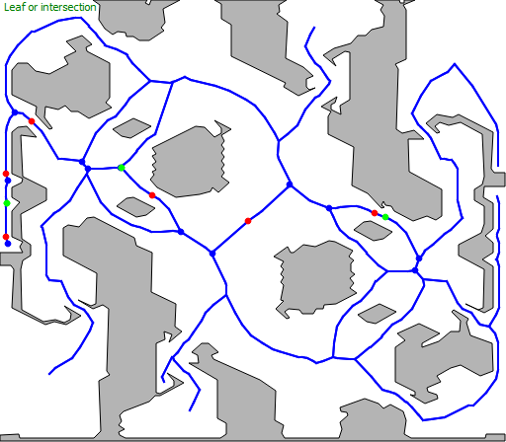
Identify Nodes
Demo

Slide 35
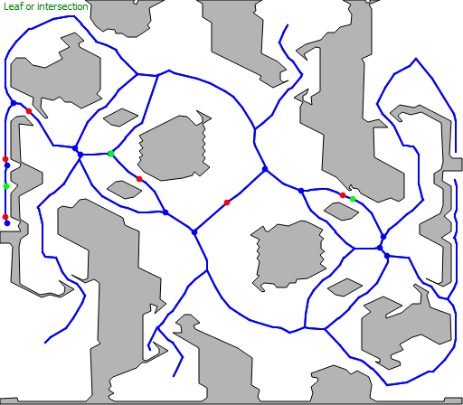
Identify Nodes
Demo

Slide 36
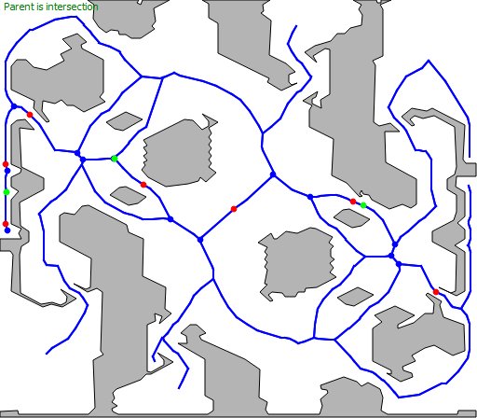
Identify Nodes
Demo

Slide 37
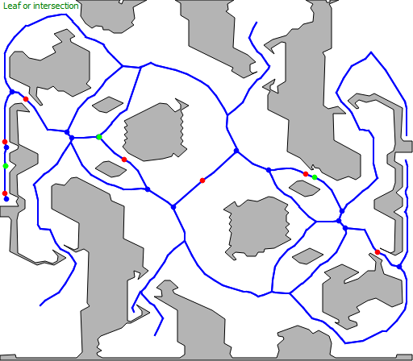
Identify Nodes
Demo

Slide 38

Identify Nodes
Demo

Slide 39
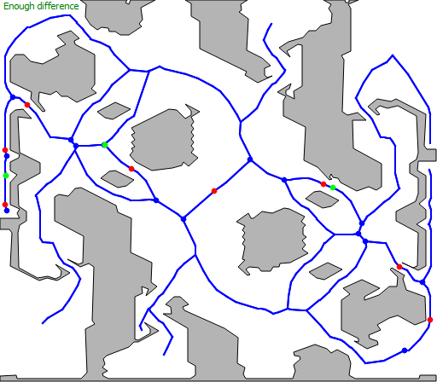
Identify Nodes
Demo

Slide 40

Identify Nodes
Demo

Slide 41

Identify Nodes
Demo

Slide 42
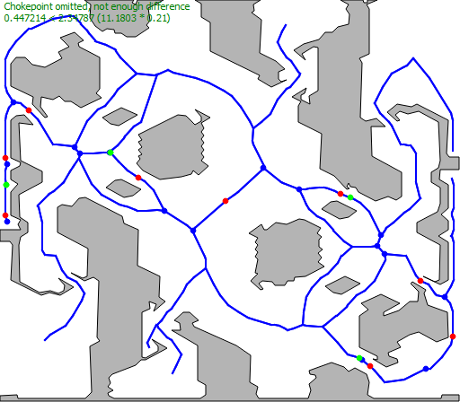
Identify Nodes
Demo

Slide 43
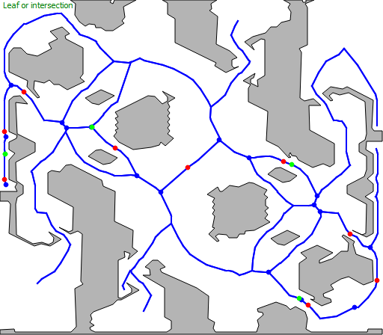
Identify Nodes
Demo

Slide 44
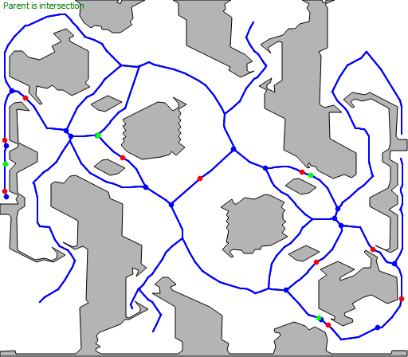
Identify Nodes
Demo

Slide 45
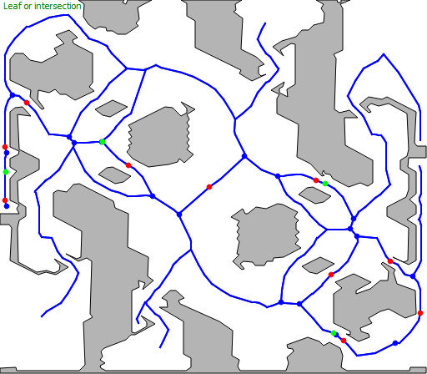
Identify Nodes
Demo

Slide 46
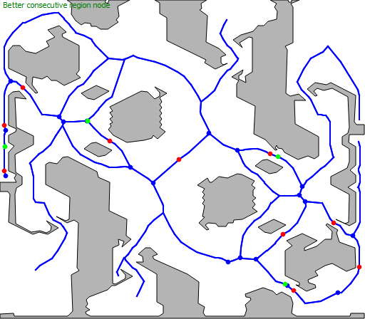
Identify Nodes
Demo

Slide 47
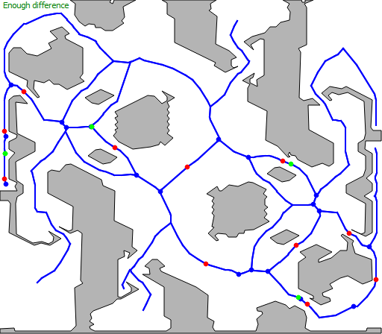
Identify Nodes
Demo

Slide 48
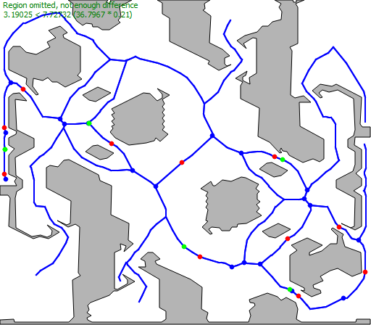
Identify Nodes
Demo

Slide 49
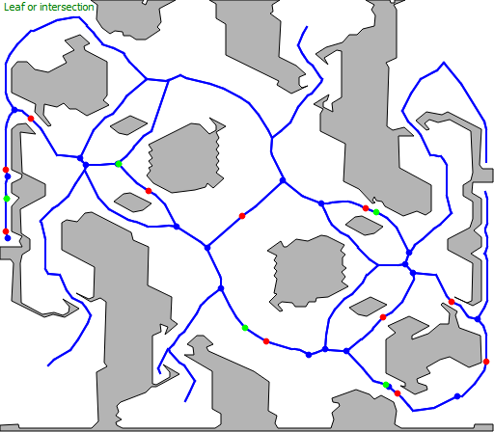
Identify Nodes
Demo

Slide 50
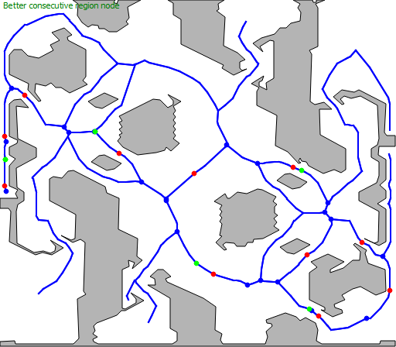
Identify Nodes
Demo

Slide 51
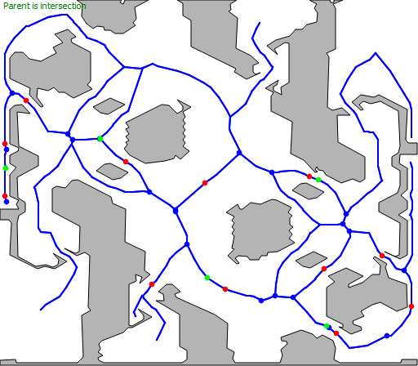
Identify Nodes
Demo

Slide 52

Identify Nodes
Demo

Slide 53

Identify Nodes
Demo

Slide 54
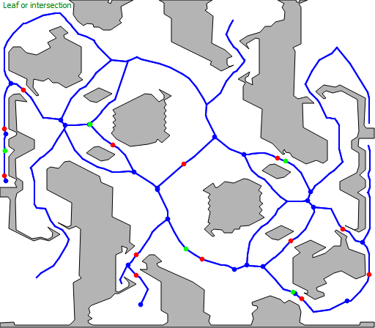
Identify Nodes
Demo

Slide 55
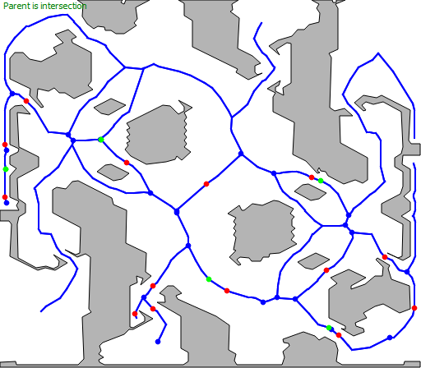
Identify Nodes
Demo

Slide 56
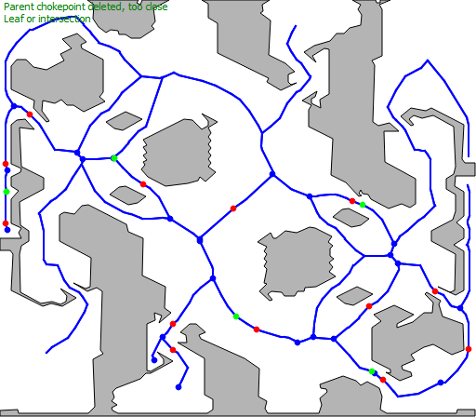
Identify Nodes
Demo

Slide 57
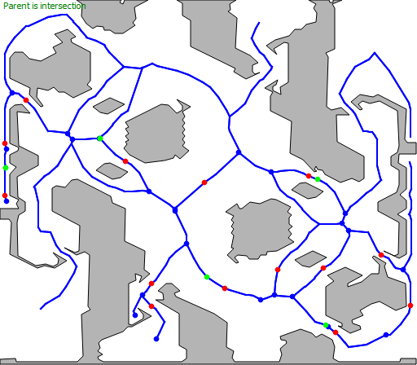
Identify Nodes
Demo

Slide 58
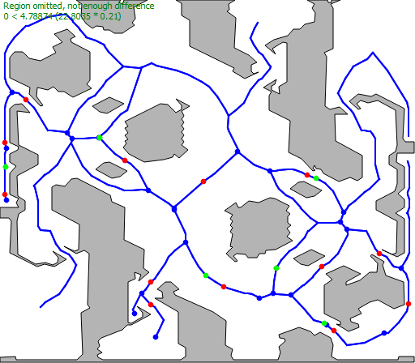
Identify Nodes
Demo

Slide 59
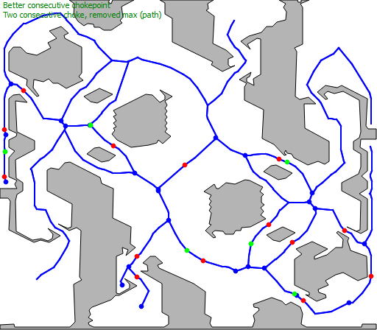
Identify Nodes
Demo

Slide 60

Identify Nodes
Demo

Slide 61
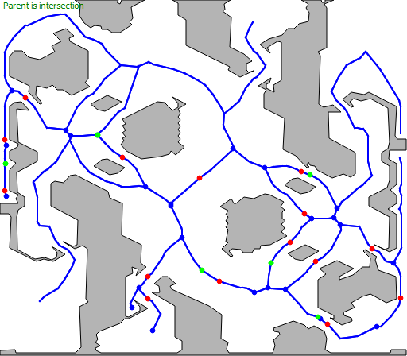
Identify Nodes
Demo

Slide 62

Identify Nodes
Demo

Slide 63

Identify Nodes
Demo

Slide 64
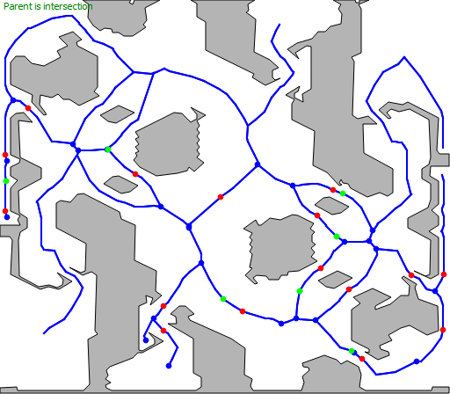
Identify Nodes
Demo

Slide 65
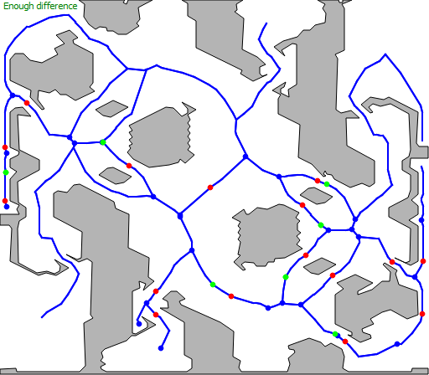
Identify Nodes
Demo

Slide 66
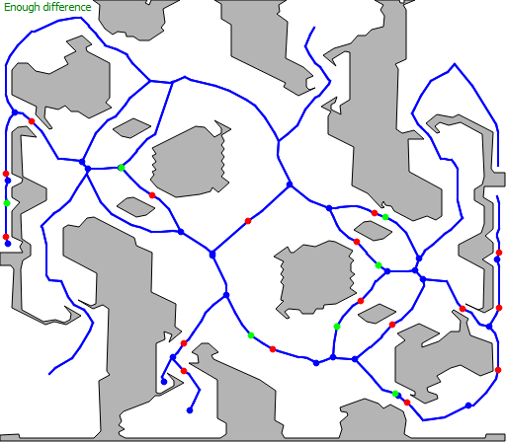
Identify Nodes
Demo

Slide 67

Identify Nodes
Demo

Slide 68
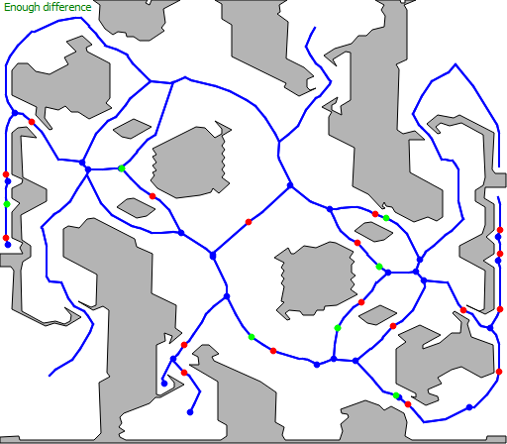
Identify Nodes
Demo

Slide 69
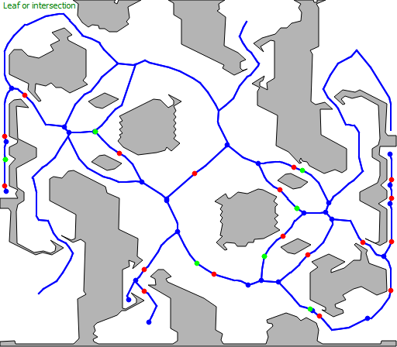
Identify Nodes
Demo

Slide 70
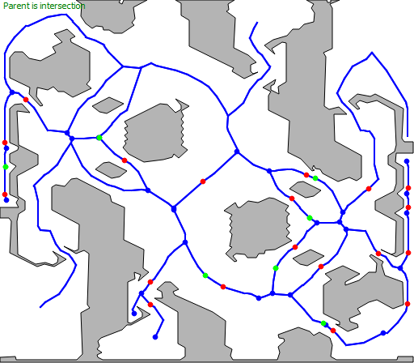
Identify Nodes
Demo

Slide 71

Identify Nodes
Demo

Slide 72

Identify Nodes
Demo

Slide 73

Identify Nodes
Demo

Slide 74

Identify Nodes
Demo

Slide 75

Identify Nodes
Demo

Slide 76
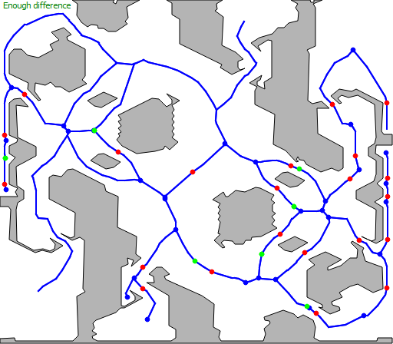
Identify Nodes
Demo

Slide 77

Identify Nodes
Demo

Slide 78

Identify Nodes
Demo

Slide 79

Identify Nodes
Demo

Slide 80

Identify Nodes
Demo

Slide 81

Identify Nodes
Demo

Slide 82

Identify Nodes
Demo

Slide 83

Identify Nodes
Demo

Slide 84

Identify Nodes
Demo

Slide 85

Identify Nodes
Demo

Slide 86

Identify Nodes
Demo

Slide 87

Identify Nodes
Demo

Slide 88

Identify Nodes
Demo

Slide 89

Identify Nodes
Demo

Slide 90

Identify Nodes
Demo

Slide 91

Identify Nodes
Demo

Slide 92

Identify Nodes
Demo

Slide 93

Identify Nodes
Demo

Slide 94

Identify Nodes
Demo

Slide 95

Identify Nodes
Demo

Slide 96

Identify Nodes
Demo

Slide 97

Identify Nodes
Demo

Slide 98

Identify Nodes
Demo

Slide 99

Identify Nodes
Demo

Slide 100

Identify Nodes
Demo

Slide 101

Identify Nodes
Demo

Slide 102

Identify Nodes
Demo

Slide 103

Identify Nodes
Demo

Slide 104

Identify Nodes
Demo

Slide 105

Identify Nodes
Demo

Slide 106

Identify Nodes
Demo

Slide 107

Identify Nodes
Demo

Slide 108

Identify Nodes
Demo

Slide 109

Identify Nodes
Demo

Slide 110

Identify Nodes
Simplify Edges

Slide 111

Identify Nodes
Merge Region Nodes

Slide 112


Identify Nodes
BWTA
BWTA2
0.374 seconds
0.000535992 seconds

Slide 113


Extract Region Polygons
BWTA
BWTA2
0.546 seconds
0.03157657 seconds

Slide 114
Extract Cache Operations
Component-Labeling of Regions

Slide 115
Extract Cache Operations
Component-Labeling of Regions
Base Locations Clustering Resources (DBSCAN)
0.78 s -> 0.0678 s

Slide 116

Extract Cache Operations
Component-Labeling of Regions
Base Locations Clustering Resources (DBSCAN)
0.78 s -> 0.0678 s
Closest Point of Interest
Base Location, Chokepoint and
Obstacle
Multi-Seed Flood-Fill

Slide 117
Extract Cache Operations
Component-Labeling of Regions
Base Locations Clustering Resources (DBSCAN)
0.78 s -> 0.0678 s
Closest Point of Interest
Base Location, Chokepoint and
Obstacle
Multi-Seed Flood-Fill
Hybrid for ground and air units

Slide 118
Extract Cache Operations
Component-Labeling of Regions
Base Locations Clustering Resources (DBSCAN)
0.78 s -> 0.0678 s
Closest Point of Interest
Base Location, Chokepoint and
Obstacle
Multi-Seed Flood-Fill
Hybrid for ground and air units
BWTA | BWTA2
47.154 s | 1.088 s

Slide 119
General Performance
Time in seconds
Map | Size | BWTA | BWTA2
Destination | 128x96 | 54.15 | 3.53
Heartbreak Ridge | 128x96 | 53.55 | 4.32
Benzene | 128x112 | 55.82 | 5.87
Aztec | 128x128 | 66.83 | 5.39

Slide 120
General Performance
Time in seconds
Map | Size | BWTA | BWTA2 | BWTA2 last
Destination | 128x96 | 54.15 | 3.53 | 1.35
Heartbreak Ridge | 128x96 | 53.55 | 4.32 | 1.31
Benzene | 128x112 | 55.82 | 5.87 | 1.40
Aztec | 128x128 | 66.83 | 5.39 | 1.60
Andromeda | 128x128 | 78.16 |  | 1.77
Fortress | 128x128 | 49.19 |  | 1.60
Python | 128x128 | 43.70 |  | 1.64

Slide 121
General Performance
Region Detection Comparison
Benzene
BWTA
BWTA2

Slide 122


General Performance
Region Detection Comparison
Destination
BWTA
BWTA2

Slide 123


General Performance
Region Detection Comparison
Aztec
BWTA
BWTA2

Slide 124


General Performance
Region Detection Comparison
Andromeda
BWTA
BWTA2

Slide 125


General Performance
Region Detection Comparison
Fortress
BWTA
BWTA2

Slide 126

General Performance
HPA* implemented
Time in milliseconds
Tile Positions | A* | HPA*
(9,84) – (69,7) | 41.13 | 0.95
(9,84) – (118,101) | 46.72 | 0.73
(69,7) – (118,101) | 41.38 | 1.09
Aztec Map
Distance Between Start Positions

Slide 127

Improving Terrain Analysis and
Applications to RTS Game AI
Alberto Uriarte albertouri@cs.drexel.edu
Santiago Ontañón santi@cs.drexel.edu
Lab looking for new PhD students!!!!

